Slide 1
Introduction to GWAS
Malachy Campbell – VT GWAS Workshop
6/24/2019

Slide 2
Overview
What is the genetic architecture of trait X?
How many genes contribute to the phenotype?
What are the genes?
How much do they influence the phenotype?

Slide 3
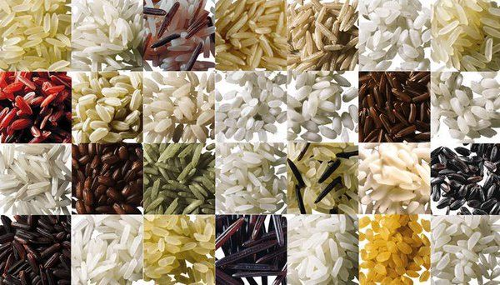
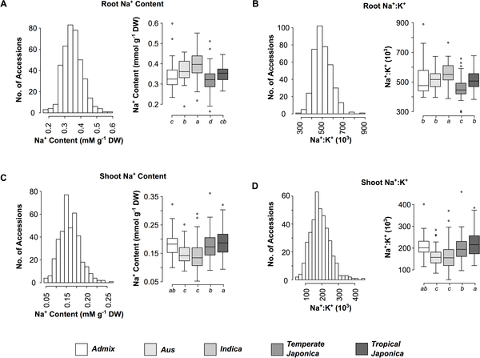
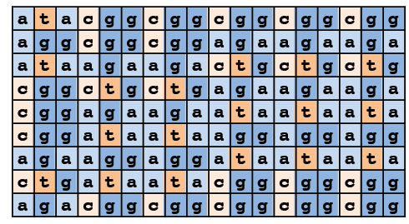
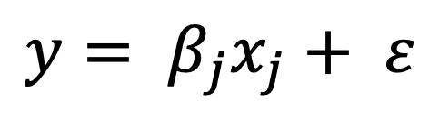
Recipe for GWAS
Diverse Population
Ingredients:
Population of distantly related individuals
Typically 200+; The more the better
Catalogue of mutations in the population
Where they occur and who has them
Phenotypic observations
What do the individuals look like?
Appropriate statistical framework to link SNP to phenotype
Phenotypes
Mutation Catalogue
$$y= β_{j}x_{j}+ ε$$

Slide 4

The mutations
Ind 1
SNP
Ind 2
Deletion
(causal
mutation)
Ind 3
Ind 4
Cannot consider deletion in linear model, only SNPs (biallelic)

Slide 5
The mutations
Ind 1
SNP
Ind 2
Deletion
(causal
mutation)
Ind 3
Ind 4
The goal of GWAS is not to recover the causal mutation, but a marker linked to it (i.e. correlated with it)

Slide 6
Marker genotypes
 | M1 | M2 | M3 | M4 | M5
I1 | AC | TG | AC | AA | TT
I2 | CC | TG | CC | CC | TG
I3 | AA | TT | AA | AC | TT
I4 | CC | GG | AC | CC | TG
I5 | AC | TT | CC | AA | TG
I6 | CC | TG | AA | AC | TT
I7 | AA | TT | CC | CC | GG
I8 | AC | TG | AC | AA | TT
I9 | CC | TG | CC | CC | TG
I10 | AA | TT | AA | AC | TT
I11 | CC | GG | AC | CC | TG
I12 | AC | TT | CC | AA | TG
I13 | CC | TG | AA | AC | TT
I14 | AA | TT | CC | CC | GG
 | M1 | M2 | M3 | M4 | M5
I1 | 1 | 1 | 1 | 0 | 0
I2 | 2 | 1 | 2 | 2 | 1
I3 | 0 | 0 | 0 | 1 | 0
I4 | 2 | 2 | 1 | 2 | 1
I5 | 1 | 0 | 2 | 0 | 1
I6 | 2 | 1 | 0 | 1 | 0
I7 | 0 | 0 | 2 | 1 | 2
I8 | 1 | 1 | 1 | 0 | 0
I9 | 2 | 1 | 2 | 2 | 1
I10 | 0 | 0 | 0 | 1 | 0
I11 | 2 | 2 | 1 | 2 | 1
I12 | 1 | 0 | 2 | 0 | 1
I13 | 2 | 1 | 0 | 1 | 0
I14 | 0 | 0 | 2 | 2 | 2
For marker 1 (M1):
A = 0
C = 1
n x m matrix of marker genotypes
n x m matrix of allele counts (allele dosage)

Slide 7
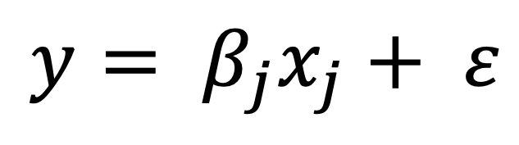
Basics of single marker regression
$$y= β_{j}x_{j}+ ε$$
 | M_{j}
I1 | 1
I2 | 2
I3 | 0
I4 | 2
I5 | 1
I6 | 2
I7 | 0
I8 | 1
I9 | 2
I10 | 0
I11 | 2
I12 | 1
I13 | 2
I14 | 0
Additive effect of SNP_{j} on phenotype

Slide 8
Single marker regression for Root Na⁺ content
36k markers
375 diverse individuals
Root Na⁺ regressed on each SNP using a linear model

Slide 9
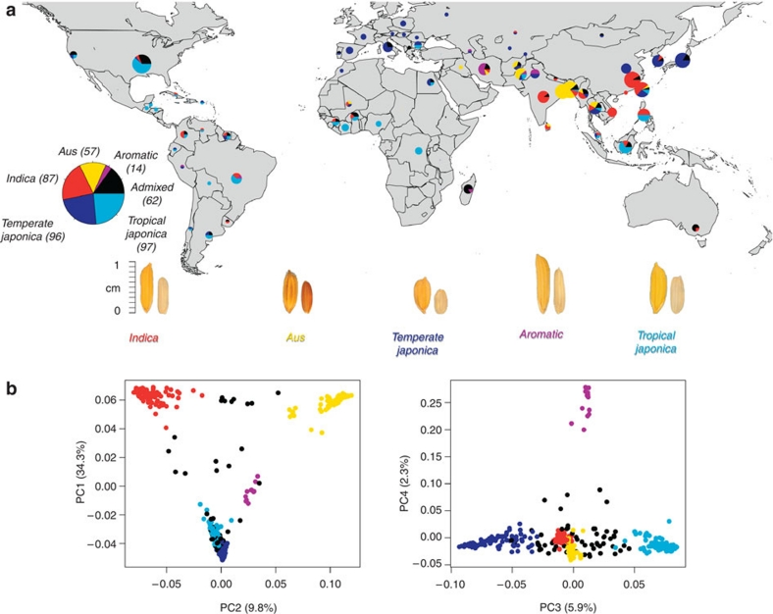
The population
Diversity!!
GWAS populations
Diversity panel: Sample the genetic diversity within a species
Rice Diversity Panel 1
Zhao et al 2011

Slide 10
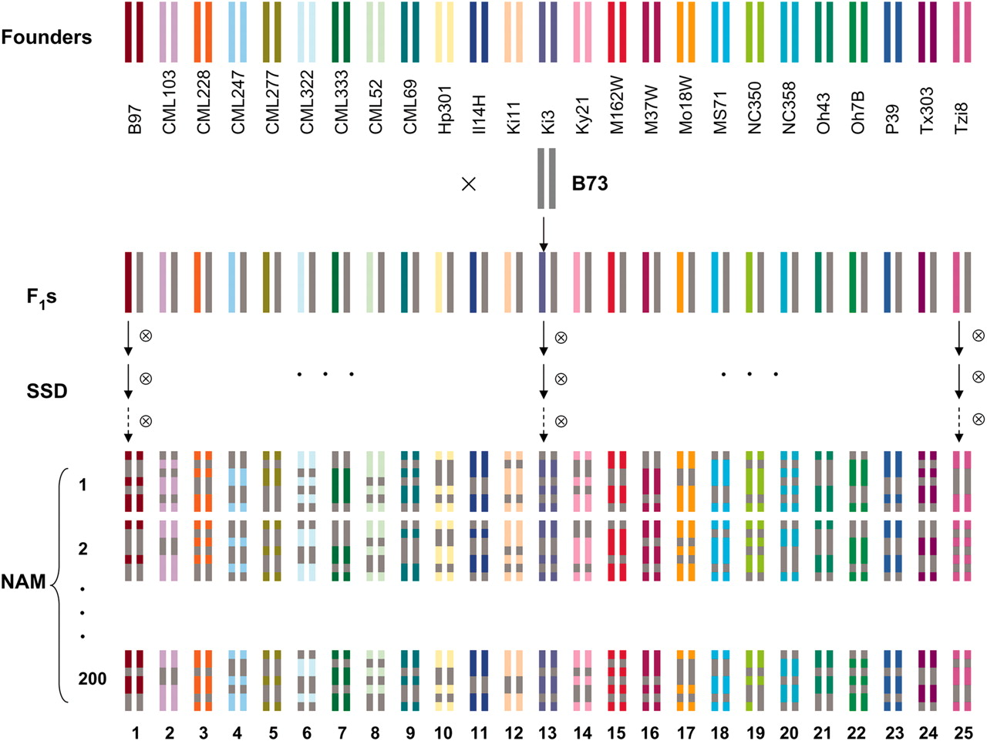
The population
Diversity!!
GWAS populations
Diversity panel: Sample the genetic diversity within a species
Nested association mapping (NAM): Diverse collection of related families
Maize NAM
Jianming Yu et al. Genetics 2008;178:539-551

Slide 11
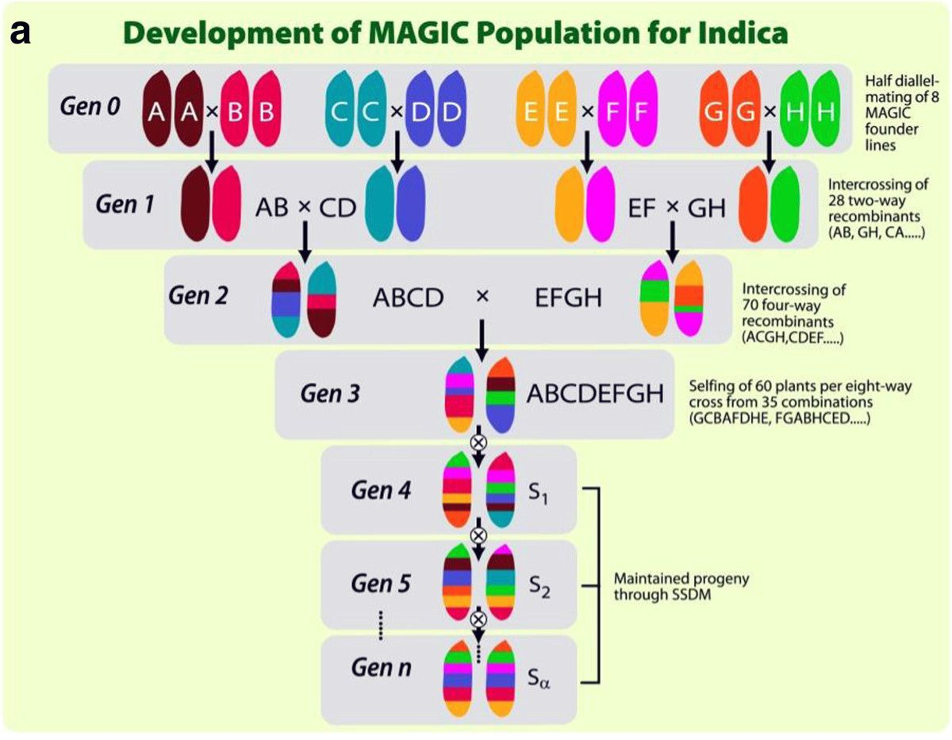
The population
Diversity!!
GWAS populations
Diversity panel: Sample the genetic diversity within a species
Nested association mapping (NAM): Diverse collection of related families
Multi-parent advanced generation inter-cross (MAGIC) population (NAM): Complex crossing schemes between diverse parents
Rice MAGIC
Bandillo et al 2013

Slide 12
The population: Rice Diversity Panel 1 (RDP1)
Non-random mating results in systematic differences in allele frequencies between subpopulations
This is population structure of stratification

Slide 13
Dealing with population structure
Question 1: What is the degree of stratification in my population?
To assess population structure:
Quantify the genetic relationships between individuals (i.e. construct a kinship matrix G)
Perform principle component analysis (PCA) on G
Examine bi-plots and scree plots

Slide 14
Dealing with population structure: Principle component analysis (PCA)
PCA: dimensional reduction technique where we reduce a covariance matrix into a set of new variables that capture much of the variance in the original data
New variables = principle components (PCs)
If we have n original variables we can construct n-1 PCs
The first PC explains the most variance, subsequent PCs explain less

Slide 15
Dealing with population structure: PCA for RDP1

Slide 16
Dealing with population structure: PCA for RDP1
Indica
Aus
Temperate
Japonica
Aromatic
Tropical
Japonica

Slide 17
Dealing with population structure
‘Elbow’ point
60% of the variance is explained by the top four PC’s

Slide 18
The effects of population structure
Stratified population and a trait that differs between subpopulations

Slide 19
Single marker regression for Root Na⁺ content
True or spurious associations?

Slide 20
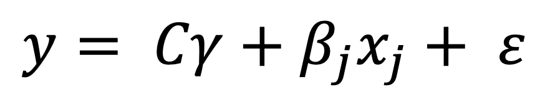
Accounting for population structure
Introduce PCs into the linear model
$$y= Cγ+β_{j}x_{j}+ ε$$
 | M_{j}
I1 | 1
I2 | 2
I3 | 0
I4 | 2
I5 | 1
I6 | 2
I7 | 0
I8 | 1
I9 | 2
I10 | 0
I11 | 2
I12 | 1
I13 | 2
I14 | 0
Top four PC’s
Additive effect of SNP_{j} on phenotype

Slide 21
Accounting for population structure with PCs
True or spurious associations?

Slide 22
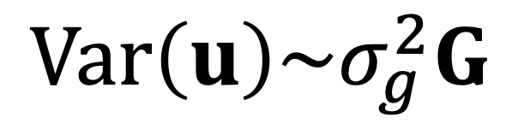
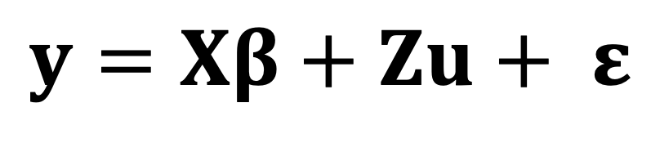
Accounting for population structure with the linear mixed model
Completely capture population structure and cryptic relatedness using the kinship matrix directly
$$y=Xβ+Zu+ ε$$
$$Var\left(u\right)\sim σ_{g}^{2}G$$
Kang et al 2008

Slide 23
Accounting for population structure with the linear mixed model

Slide 24
Accounting for population structure with the linear mixed model + PCs

Slide 25
Multiple testing
What is significant?

Slide 26
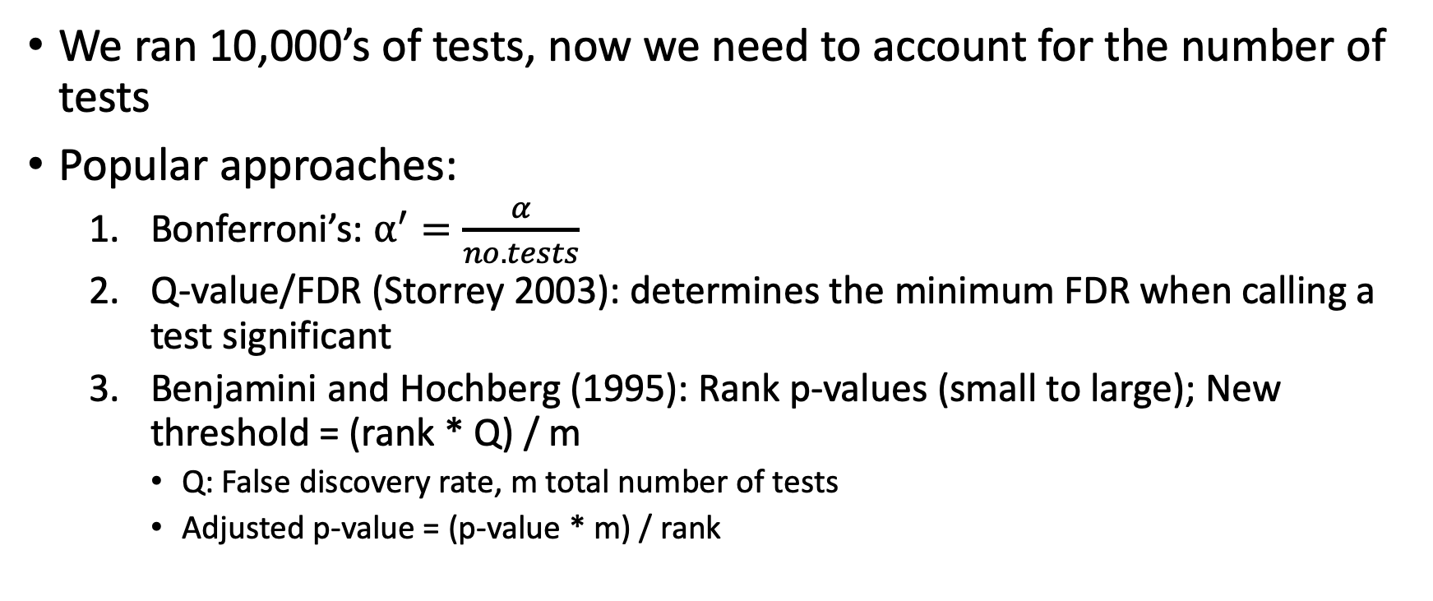
Multiple testing approaches
We ran 10,000’s of tests, now we need to account for the number of tests
Popular approaches:
Bonferroni’s: $α^{′}=\frac{α}{no. tests}$
Q-value/FDR (Storrey 2003): determines the minimum FDR when calling a test significant
Benjamini and Hochberg (1995): Rank p-values (small to large); New threshold = (rank * Q) / m
Q: False discovery rate, m total number of tests
Adjusted p-value = (p-value * m) / rank

Slide 27
Multiple testing approaches
We ran 10,000’s of tests, now we need to account for the number of tests
Popular approaches:
Bonferroni’s: $α^{′}=\frac{α}{no. tests}$
Q-value/FDR (Storrey 2003): determines the minimum FDR when calling a test significant
Benjamini and Hochberg (1995): Rank p-values (small to large); New threshold = (rank * Q) / m
Q: False discovery rate, m total number of tests
Adjusted p-value = (p-value * m) / rank
Not optimal approaches when tests are not independent

Slide 28
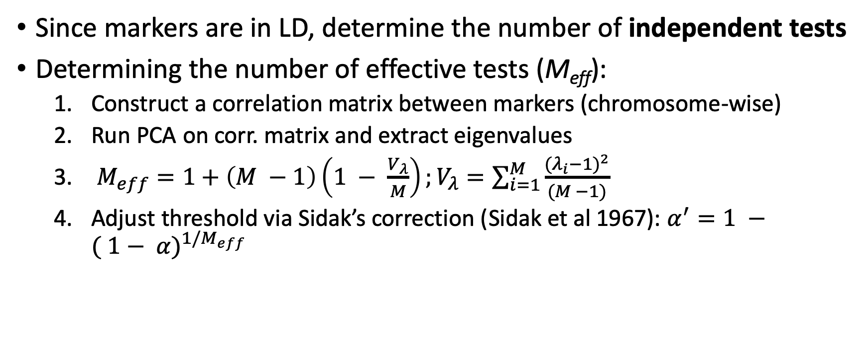
Multiple testing approaches: Li and Ji (2005)
Since markers are in LD, determine the number of independent tests
Determining the number of effective tests (M_{eff}):
Construct a correlation matrix between markers (chromosome-wise)
Run PCA on corr. matrix and extract eigenvalues
$M_{eff}=1+\left(M −1\right)\left(1 − \frac{V_{λ}}{M}\right);V_{λ}=\sum_{i=1}^{M}{\frac{{{(λ}_{i}−1)}^{2}}{(M −1)}}$
Adjust threshold via Sidak’s correction (Sidak et al 1967): $α^{′}=1 −{( 1− α)}^{1/M_{eff}}$

Slide 29
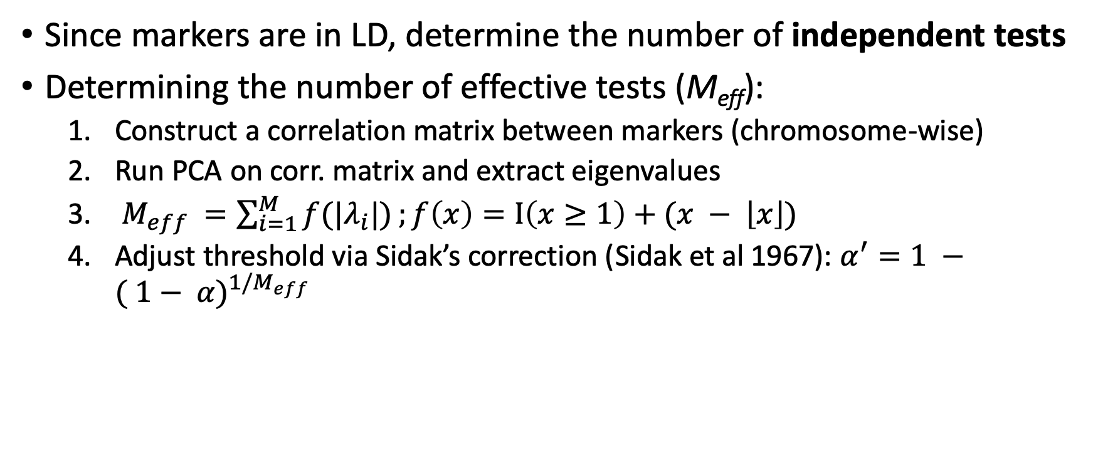
Multiple testing approaches: Li and Ji (2005)
Since markers are in LD, determine the number of independent tests
Determining the number of effective tests (M_{eff}):
Construct a correlation matrix between markers (chromosome-wise)
Run PCA on corr. matrix and extract eigenvalues
$M_{eff} =\sum_{i=1}^{M}{f(|λ_{i}|)};f\left(x\right)=I\left(x≥1\right)+(x − \left\lfloor x\right\rfloor )$
Adjust threshold via Sidak’s correction (Sidak et al 1967): $α^{′}=1 −{( 1− α)}^{1/M_{eff}}$

Slide 30
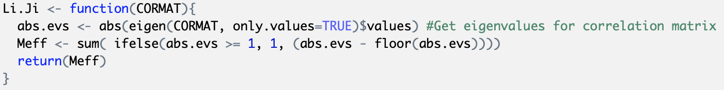
Multiple testing approaches: Li and Ji (2005)

Slide 31
Pre-GWAS Quality Control (QC)
Marker-based QC:
Correlated markers
Missing data
Minor allele frequency
Individual-based QC:
Low genotyping rate

Slide 32
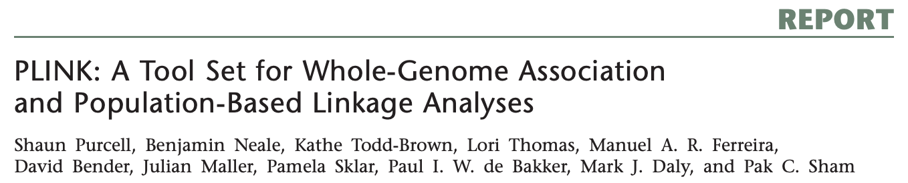
Pre-GWAS Quality Control (QC)
Marker-based QC:
Correlated markers
Missing genotypes
Minor allele frequency
Individual-based QC:
Low genotyping rate
Independent of missingness for phenotypes

Slide 33
Pre-GWAS Quality Control (QC): Correlated Markers
If markers are in perfect LD, including both in GWAS provides no additional information
Pruning: Remove SNPs with r > some threshold
PLINK keeps the SNP with the higher frequency
Threshold = variance inflation factor
plink --file sativas413 --indep 10 1 2.77 --recode --make-bed --out Osativa.pruned
Threshold
VIF = 1/(1-r²)
PLINK formatted
genotypes
Window to
calculate LD
Step Size

Slide 34
Pre-GWAS Quality Control (QC): Missingness per individual
Individuals with poor genotyping rate should be removed
Reject if 10-20% markers are missing for individuals
plink --file sativas413 --mind 0.1 --recode --make-bed --out Osativa.pruned
PLINK formatted
genotypes
Proportion of markers missing

Slide 35
Pre-GWAS Quality Control (QC): Missingness per marker
Markers with high missingness should be removed
Reject if 10-30% individuals with observations have missing data at marker
plink --file sativas413 --geno 0.1 --recode --make-bed --out Osativa.pruned
PLINK formatted
genotypes
Proportion of individuals missing

Slide 36
Pre-GWAS Quality Control (QC): Minor allele frequency
Minor allele: the allele that is present at lower frequency
Major allele: the allele that is present at higher frequency
 | M1
Ind1 | AA
Ind2 | AG
Ind3 | AA
Ind4 | AG
Ind5 | GG
Ind6 | AG
Ind7 | GG
Ind8 | AA
Ind9 | AG
Ind10 | AA
Ind11 | AG
Ind12 | GG
A: 13
G: 11
No Ind: 12
MAF = 0.46
Rare causal alleles (low MAF) are difficult to recover; require large sample sizes (1K – 10K+ indiv.)
< 1000 individuals: keep markers with MAF > 0.05
1000+: keep markers with MAF > 0.01
Minor allele

Slide 37
Pre-GWAS Quality Control (QC): LD thinning
M1
M2
M3
M4
SNP
 | M1 | M2 | M3 | M4
M1 | 1 | 1 | 1 | 0.8
M2 | 1 | 1 | 1 | 1
M3 | 1 | 1 | 1 | 1
M4 | 0.8 | 1 | 1 | 1

Slide 38
Pre-GWAS Quality Control (QC): LD thinning
M1
M2
M3
M4
SNP
 | M1 | M2 | M3 | M4
M1 | 1 | 1 | 1 | 0.8
M2 | 1 | 1 | 1 | 1
M3 | 1 | 1 | 1 | 1
M4 | 0.8 | 1 | 1 | 1
Is it worth fitting all markers?

Slide 39

Questions??

